Slide 1


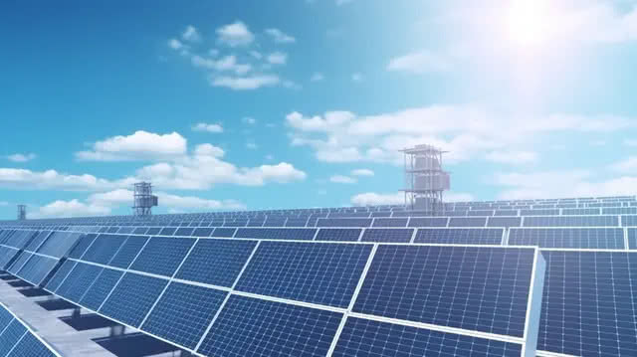


An Integrated Analysis of Cloud Computing’s Environmental Sustainability, Economic Competitiveness and Social Well-Being towards Sustainable Development
Presented By:
Hemant Kumar Singh¹ and Bharat Raj Singh²
¹Khwaja Moinuddin Chishti Language University, Lucknow
email: hemantbib@gmail.com
²Director General (Technical),
School of Management Sciences, Lucknow
email: brsingh@smslucknow.ac.in

Slide 2
Presentation Agenda
Green Cloud Computing
Environmental Sustainability: Green Practices and Impact
Economic Competitiveness: Cost Efficiency and Innovation
Social Well-Being: Digital Inclusion and Collaboration
Drivers and Techniques of Green Cloud Computing
Literature Review Highlights
Future Trends and Recommendations

Slide 3
Abstract
Cloud computing has swiftly become a essential technology in today’s digital world, and its rising influence offers meaningful opportunities to support sustainable development. This paper delivers an integrated analysis of how cloud computing contributes to environmental sustainability, economic competitiveness and social well-being. On the environmental side, the study argues how cloud-based systems help decrease energy consumption, reduce carbon emissions and promote the use of more proficient and eco-friendly data centers. From an economic perspective, the paper highlights how cloud services minimises infrastructure costs, improve scalability, encourage innovation and strengthen the competitiveness of businesses and organizations. The social dimension focuses on the role of cloud technology in improving digital access, supporting remote collaboration, improving public service delivery and boosting sectors such as education and healthcare. Together, these insights indicates that cloud computing is a important driver of sustainable development, helping balance environmental responsibility with economic growth and societal development. The paper concludes by emphasizing the importance of supportive policies, continuous technological advancements and responsible cloud adoption to fully realize these long-term advantages.

Slide 4
Green Cloud Computing
Green Cloud Computing refers to the practices and technologies designed to reduce the carbon footprint, lower energy use and reduce the overall environmental impact of cloud services.
Sustainable development is important because it helps us use resources in a way that is good for the environment, society and the economy

Slide 5
Cloud Computing Services
Infrastructure as a Service (IaaS):
Provides virtualized computing resources over the internet.
Largest public cloud service providers –
Amazon Web Services (AWS), Google and Microsoft
S3 , EC2, Google Compute Engine.

Slide 6
Platform as a Service (PaaS)
Platform as a Service (PaaS) provides hardware and software infrastructure that you can use to develop and maintain applications. The cloud provider hosts the hardware and the software development tools in its data center. You can build, test, run, and scale applications faster and at a lower cost by using PaaS than on your on-premises infrastructure.
Example: Google App Engine, Force.com, Windows Azure, Cloud run

Slide 7
Software as a Service (SaaS):
Provides the entire software application over the internet. You can use it to perform different tasks. The cloud provider hosts the hardware, the software tools, and the application itself in its data center.
Dropbox, gmail, Google drive,Google doc etc

Slide 8
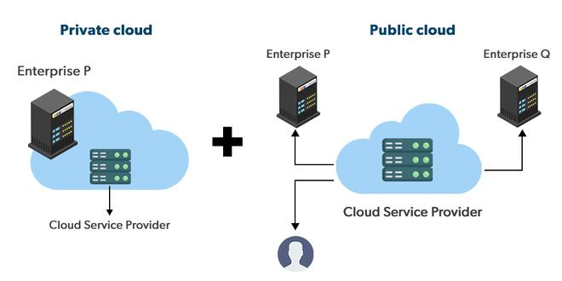
Hybrid Cloud

Slide 9
Literature review
Technical Perspectives on Sustainable Cloud Computing
Year | Authors | Focus Area | Key Contribution | Why It Is Useful
2020 | R. Verma, N. Gupta | Environmental Impact of Cloud DCs | Highlighted energy consumption patterns and carbon footprint of Indian cloud data centers. | Helps researchers understand baseline environmental challenges in cloud systems.
2021 | L. Kumar, P. Sharma, M. Ahmed | Green IT Architecture | Proposed sustainable architectures for reducing cloud energy usage. | Provides early architectural blueprints for designing energy-efficient cloud setups.
2022 | Y. Zhang, H. Li | Technical Barriers in Cloud Sustainability | Analyzed technical limitations like cooling inefficiencies and virtualization overhead. | Identifies bottlenecks that must be addressed to improve cloud sustainability.
2023 | A. Patel, J. Singh | AI-driven Optimization | Introduced machine learning techniques for cloud energy optimization. | Demonstrates how AI can enhance efficiency and reduce energy waste in cloud platforms.
2024 | T. Wang, X. Zhao | Carbon-aware Scheduling | Developed workload scheduling models to minimize carbon emissions. | Provides actionable scheduling strategies for reducing carbon footprints in real-time workloads.
2025 | S. Mehra, D. Thomas | Net-zero Cloud Infrastructure | Explored emerging net-zero cloud technologies and circular digital systems. | Supports long-term planning toward carbon-neutral and resource-efficient cloud ecosystems.

Slide 10
Economic Perspectives on Sustainable Cloud Computing
Year | Authors | Focus Area | Key Contribution | Why It Is Useful
2021 | B. Rao, K. Banerjee | Economic Benefits of Sustainable Cloud | Identified cost savings in sustainable IT adoption. | Helps organizations justify investments in sustainable cloud solutions.
2022 | M. Rahimi, L. Fernandez | Cloud Migration Costs | Assessed economic barriers in cloud adoption. | Highlights financial challenges to guide better planning for cloud migration.
2023 | F. Hassan, R. Choi | Cost-efficient Cloud Operations | Used AI for optimizing cloud resources and reducing operational costs. | Shows how intelligent optimization can lower expenses while improving efficiency.
2024 | P. Nelson, J. Gordon | Renewable-powered Cloud | Economically evaluated cloud data centers powered by renewables. | Provides insight into financial feasibility of clean energy-powered cloud systems.
2025 | I. Das, F. Romero | Circular Economy for Cloud | Proposed cost models for circular and resource-efficient cloud platforms. | Guides adoption of circular economy principles to reduce costs and resource waste.

Slide 11
Social Perspectives on Sustainable Cloud Computing
Year | Authors | Focus Area | Key Contribution | Why It Is Useful
2020 | H. Singh, R. Mehta | Public Awareness of Cloud Impacts | Examined public perception of cloud sustainability. | Helps understand how society views cloud sustainability and identifies awareness gaps.
2021 | S. Das, M. Narang | Social Acceptance of Green Cloud | Studied user acceptance of sustainable cloud tools and remote work. | Provides insights into adoption behavior, which can guide sustainable technology implementation.
2022 | K. Lee, A. Brown | Privacy & Ethical Issues | Identified social concerns like privacy and workforce transformation. | Highlights ethical challenges that must be addressed for socially responsible cloud adoption.
2023 | V. Kumar, N. Roy | Remote Work & Emission Reduction | Showed how cloud enables sustainable lifestyle shifts. | Demonstrates the social and environmental benefits of cloud-enabled remote work.
2024 | A. Ibrahim, P. Omar | Digital Inclusion & Society | Analyzed how cloud improves digital access and equality. | Supports policies and strategies for reducing the digital divide through cloud services.
2025 | R. Sato, L. Mendes | Ethical Cloud Ecosystems | Discussed digital rights, social responsibility, and ethical cloud use. | Guides the development of responsible, ethical, and inclusive cloud platforms.

Slide 12
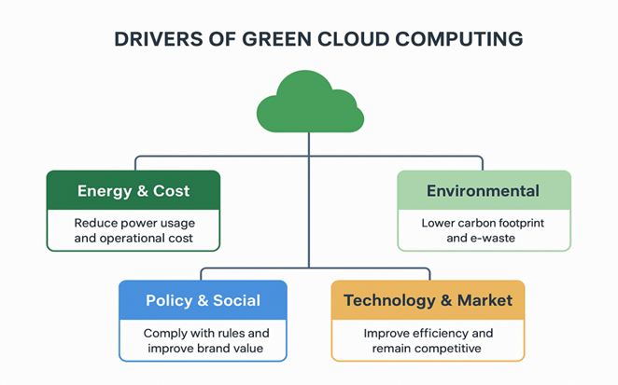
Drivers of Green Cloud Computing

Slide 13
Techniques and Technologies in Green Cloud Computing
1. Virtualization: Think of virtualization as dividing one powerful computer into many smaller virtual ones. This helps reduce the number of physical machines needed, which automatically cuts energy use and heat generation.
2. Server Consolidation: Instead of running many half-empty servers, cloud providers pack multiple workloads onto fewer machines. This means fewer servers to power, cool and maintain, saving electricity and money.
3. Dynamic Resource Allocation: Resources like CPU, memory and storage are given out only when needed. This prevents energy waste because servers don’t stay powered at full capacity when there’s no work to do.
4. Energy-Efficient Hardware: Modern cloud data centers use low-power chips, efficient storage devices (like SSDs), and smarter cooling systems. These technologies help cut down electricity consumption without affecting performance.
5. Renewable Energy Usage: Many big cloud companies run their data centers on solar, wind, or hydropower. This reduces their carbon footprint and makes cloud services more eco-friendly.

Slide 14
6. Green Data Centers: These are specially designed buildings that use natural cooling, intelligent layouts, and controlled temperatures to reduce energy usage. Some even use outside air or liquid cooling instead of traditional AC systems.
7. Load Balancing: Load balancing spreads tasks evenly across servers so that no single server gets overloaded. This helps all machines run smoothly and efficiently, reducing overall power usage.
8. Containers (Docker, Kubernetes): Containers are lighter than virtual machines. They use fewer resources, start faster, and allow applications to run efficiently without wasting energy.
9. Advanced Cooling Techniques: Techniques like liquid immersion cooling, free-air-cooling, and AI-based cooling significantly reduce the power required to keep servers from overheating.

Slide 15
Future Trends and Research Directions
Green cloud computing is expected to become even smarter, cleaner, and more efficient. Future research and innovation may move in the following directions:
1. AI-Based Renewable Energy Forecasting: Artificial Intelligence can help predict how much solar or wind energy will be available at different times. This allows data centers to plan their energy usage better and rely more on renewable sources instead of traditional electricity.
2. Carbon-Aware Global Workload Migration: In the future, cloud workloads may automatically shift to regions where electricity is cleaner and has a lower carbon footprint. For example, if one region is currently powered by coal but another is running on wind energy, tasks can move to the greener region to reduce emissions.
3. 100% Renewable-Powered Data Center Clusters: Researchers are working toward building fully renewable data centers that run entirely on solar, wind, hydro, or geothermal energy. The goal is to operate large-scale cloud clusters without relying on fossil fuels at all.
4. Green Cooling and Advanced Thermal Management: New cooling technologies—like liquid cooling, immersion cooling, or AI-controlled temperature systems—will reduce the energy needed to keep servers cool. Future systems will be smarter and able to adjust cooling automatically based on real-time heat levels.

Slide 16
Conclusion
Green Cloud Computing is becoming increasingly important as we move toward a more sustainable digital world. By using renewable energy, smarter resource scheduling, energy-efficient virtualization, and greener networking techniques, cloud providers can greatly reduce their carbon footprint. This review has explored the key technologies, frameworks and future directions in this field. Overall, it is clear that sustainable cloud computing will play a major role in shaping an eco-friendly and energy-efficient future for modern technology.

Slide 17
References
J. Chandramohan and U. Ramasamy, “A sustainable inventory model for growing items considering carbon emissions, product expiry, and profit-sharing policy,” Journal of Future Sustainability, vol. 3, no. 4, pp. 201–222, 2023.
M. Ram, S. Selvabaskar, R. Guhan, and K. Rajarathi, “The effect of digital communication technologies in retail supply chain management: Evidence from Indian small retailers,” Journal of Future Sustainability, vol. 3, no. 3, pp. 125–132, 2023.
M. Ghasemi, M. Rajabi, and S. Aghakhani, “Towards sustainability: The effect of industries on CO₂ emissions,” Journal of Future Sustainability, vol. 3, no. 2, pp. 107–118, 2023
S. K. Sahoo and S. S. Goswami, “Theoretical framework for assessing the economic and environmental impact of water pollution: A detailed study on sustainable development of India,” Journal of Future Sustainability, vol. 4, no. 1, pp. 23–34, 2024.
M. Rahman, S. Wahab, and A. Latiff, “Organizational sustainability: Issues, challenges and the future of Bangladesh pharmaceutical industry,” Journal of Future Sustainability, vol. 2, no. 4, pp. 157–166, 2022.
S. S. Goswami and D. K. Behera, “Solving material handling equipment selection problems in an industry with the help of entropy integrated COPRAS and ARAS MCDM techniques,” Process Integration and Optimization for Sustainability, vol. 5, no. 4, pp. 947–973, 2021.
D. Biswas, “A succinct state-of-the-art survey on green cloud computing,” Sustainable Computing: Informatics and Systems, vol. 44, 2024, Article 101038.
R. Verma and N. Gupta, “Environmental impact assessment of Indian cloud data centers,” Int. J. Green Comput., vol. 10, no. 3, pp. 45–57, 2020.
L. Kumar, P. Sharma, and M. Ahmed, “Green IT architectures for sustainable cloud computing,” Sustain. Comput. Informatics Syst., vol. 31, pp. 100–112, 2021.
Y. Zhang and H. Li, “Technical barriers to sustainable cloud computing: A comprehensive review,” IEEE Access, vol. 10, pp. 85621–85635, 2022.
A. Patel and J. Singh, “AI-driven optimization strategies for energy-efficient cloud infrastructures,” J. Cloud Comput., vol. 12, no. 4, pp. 1–14, 2023.
T. Wang and X. Zhao, “Carbon-aware workload scheduling models for next-generation sustainable cloud systems,” IEEE Trans. Sustain. Comput., vol. 9, no. 1, pp. 22–34, 2024.

Slide 18
S. Mehra and D. Thomas, “Toward net-zero cloud computing: Energy-proportional servers and circular digital infrastructure,” Future Internet, vol. 17, no. 1, pp. 1–18, 2025.
B. Rao and K. Banerjee, “Economic benefits of sustainable cloud adoption: A cost-efficiency analysis,” Journal of Green Information Systems, vol. 10, no. 2, pp. 45–54, 2021.
M. Rahimi and L. Fernandez, “Evaluating the economic barriers of cloud migration in modern enterprises,” in Proc. Int. Conf. Cloud Economics and Systems (ICES), 2022, pp. 112–120.
F. Hassan and R. Choi, “AI-based optimization for cost-efficient cloud operations,” IEEE Trans. Cloud Computing, vol. 11, no. 1, pp. 89–101, 2023.
P. Nelson and J. Gordon, “Economic feasibility of renewable-powered cloud data centers,” Sustainable Computing: Informatics and Systems, vol. 42, pp. 1–12, 2024.
I. Das and F. Romero, “Circular-economy-oriented cost models for sustainable cloud platforms,” in Proc. IEEE Int. Conf. Sustainable Digital Infrastructure (ICSDI), 2025, pp. 55–64.
H. Singh and R. Mehta, “Public awareness of cloud sustainability impacts,” Journal of Environmental Informatics, vol. 18, no. 2, pp. 112–120, 2020.
S. Das and M. Narang, “Social acceptance of green cloud technologies in remote-work environments,” in Proc. IEEE Int. Conf. on Cloud Sustainability (ICCS), 2021, pp. 45–52.
K. Lee and A. Brown, “Privacy and ethical considerations in modern cloud ecosystems,” IEEE Trans. Cloud Comput., vol. 10, no. 1, pp. 33–44, 2022.
V. Kumar and N. Roy, “Cloud-enabled remote work and its contribution to emission reduction,” Sustainable Computing: Informatics and Systems, vol. 38, pp. 200–208, 2023.
A. Ibrahim and P. Omar, “Digital inclusion through cloud platforms: A social perspective,” in Proc. ACM Symp. on Computing for Development (ACM DEV), 2024, pp. 91–100.
R. Sato and L. Mendes, “Ethical cloud ecosystems: Digital rights and social responsibility in cloud environments,” IEEE Access, vol. 13, pp. 55678–55687, 2025.

